Slide 1
How to Teach Computers to Recognize Things S3: Object Recognition: Building our Real-life “Textbooks”
Dr. Du Pengfei
SVS/DMD
11 July 2024

Slide 2

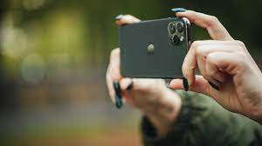
Recap
Image Filtering and preparation towards Perfect Textbook
Two Hands-On Project
Bear in Mind while conducting your AI Project:
Is Data sufficient for training?
Is Data of high quality including all scenarios without bias?
Car Or Cup | Fruit Fooled | Rock Paper Scissors
2 labels Image Classification Online images ONLY Easy Task | > 2 labels Image Classification [Fruit Classification] Online images ONLY Intermediate Task | > 2 labels Image Classification of Hand-gesture Local representation + Online images Advanced Task

Slide 3
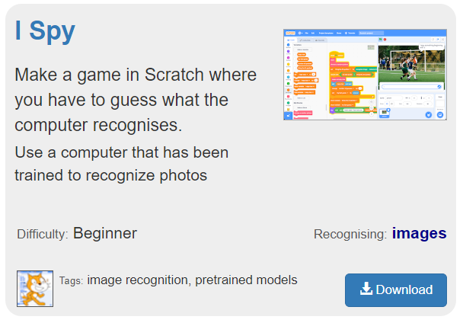
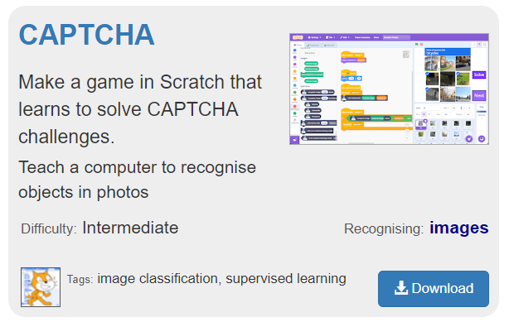
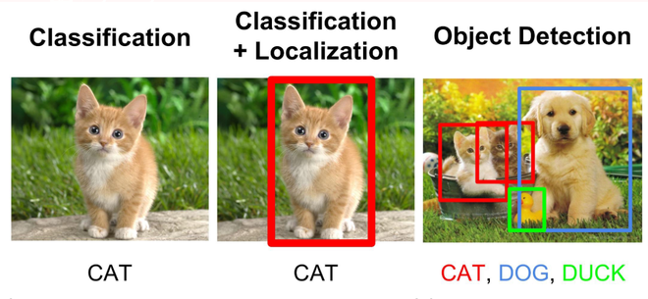
Agenda
Aim: towards Building our close-to-real-life“Textbooks” for AI !
First Hands-on Project: Meet out Student -- Pre-trained Model
Second Hands-on Project: Image Detection
Transfer Learning: Connect knowledge in the Brain

Slide 4

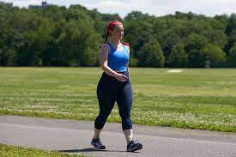
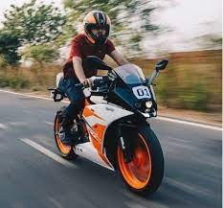
Transfer Learning: Connect knowledge in the Brain
Transfer learning (TL) is a research problem in machine learning (ML) that focuses on applying knowledge gained while solving one task to a related task.
Student A
Student B

Slide 5
Transfer Learning: Connect knowledge in the Brain
Transfer learning (TL) is a research problem in machine learning (ML) that focuses on applying knowledge gained while solving one task to a related task.
Pre-trained Models
From Scratch

Slide 6
Meet out Student -- Pre-trained Model: ImageNet

Slide 7
Let’s Start with Project I-Spy https://machinelearningforkids.co.uk/

Slide 8
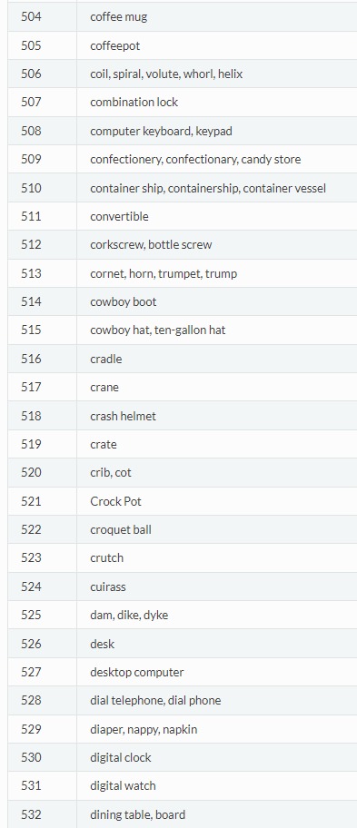
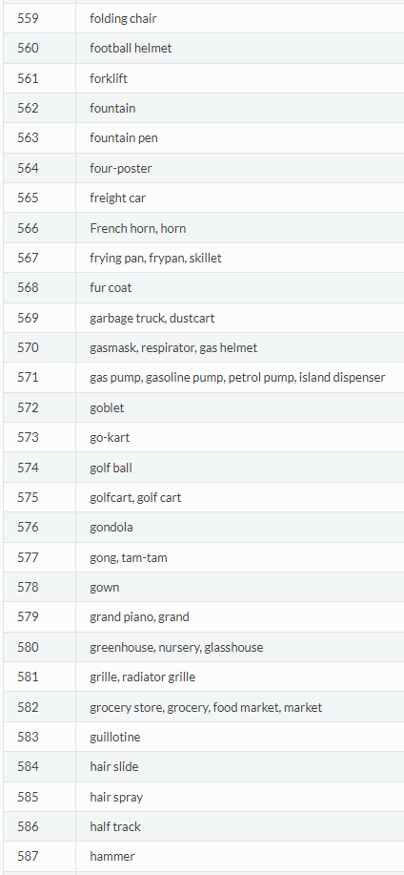
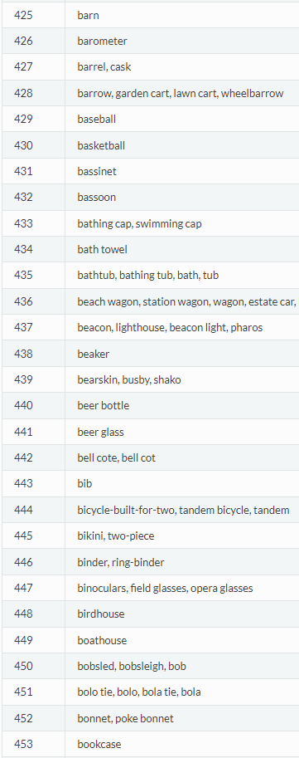
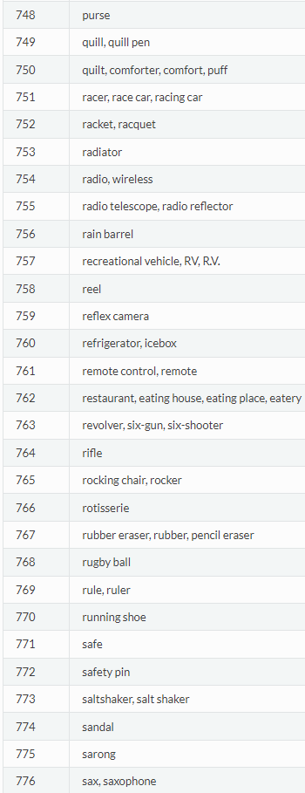
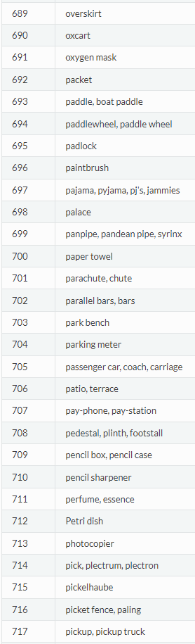
Meet out Student -- Pre-trained Model: ImageNet

Slide 9
Classification VS Detection
Output: Text ONLY
Output: Text + Boundingbox

Slide 10
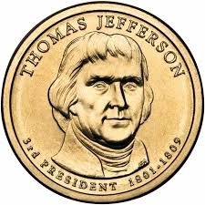
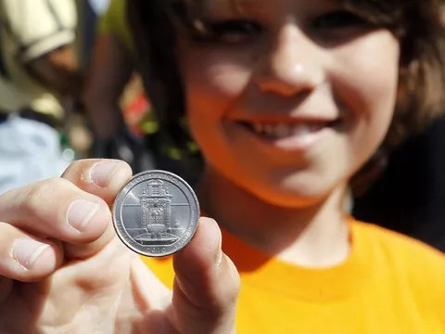
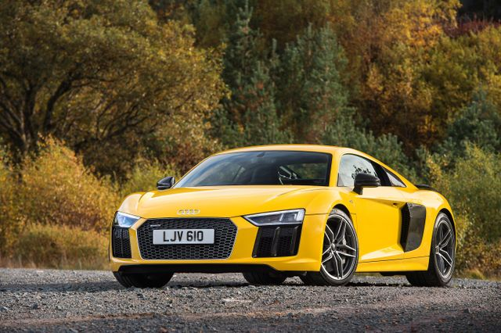

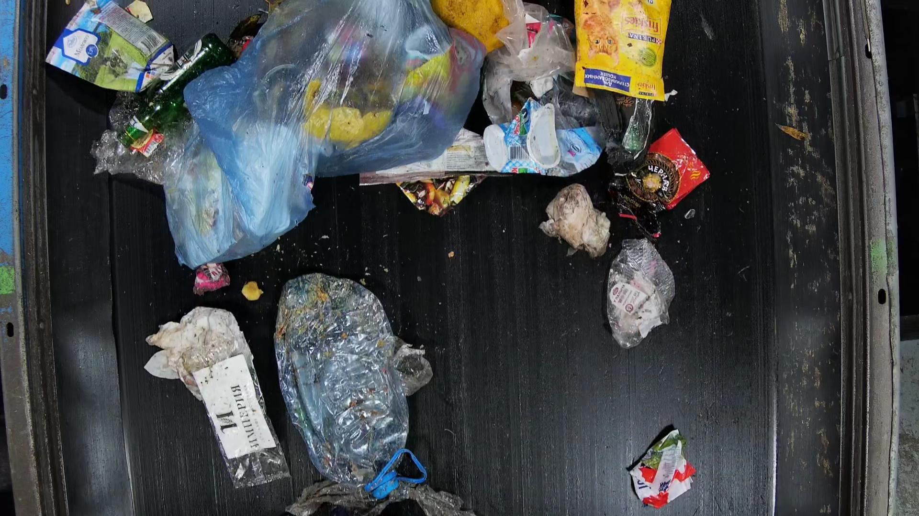

Object Detection: Teach AI in More Real-life Environment
Classification helps AI learn in a controlled environment, while Object Detection will be more practical learning.

Slide 11
Object Detection: Teach AI in a Closer-to-Real-life Environment
Classification helps AI learn in a controlled environment
Detection helps AI learn in a less-controlled environment
No blurry images
Assure one single object per image
Complete Object
Relatively clear background
No blurry images
OK to have Multiple objects
Ok to have partial Object only if Major features exists
Relatively clear background

Slide 12
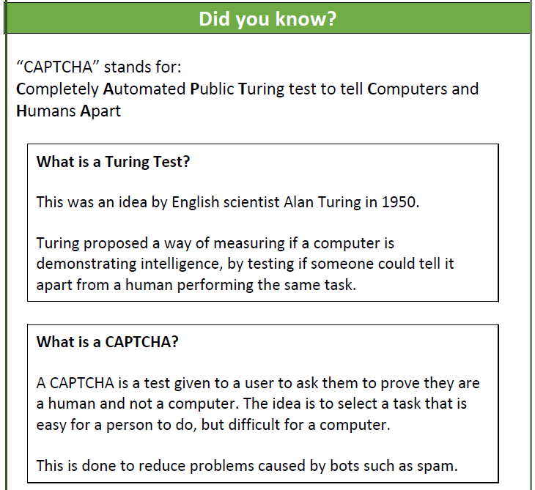
Object Detection: Project CAPTCHA
Similar AI model with breaking one image to pieces during both training and being used.

Slide 13
Let’s Start with Project CAPTHA

Slide 14
Contact: Du Pengfei
du_pengfei@SIMTech.a-star.edu.sg

